Slide 1
COUNTABLE / UNCOUNTABLE NOUNS
Universidad de Cundinamarca
Professor´s name: Nancy Sánchez

Slide 2

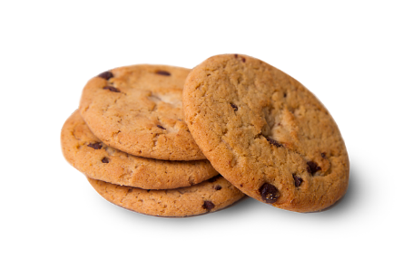
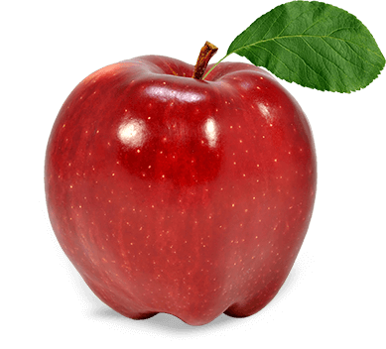
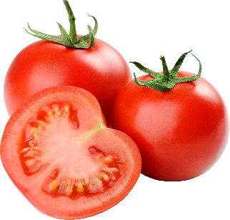
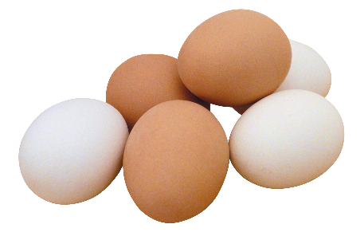
1. COUNTABLE NOUNS
Singular
Things you can count in units.
One apple, two apples, three apples…
One cookie, two cookies, three cookies…
One egg, two eggs, three eggs…
One tomato, two tomatoes, three tomatoes..…
Plural

Slide 3

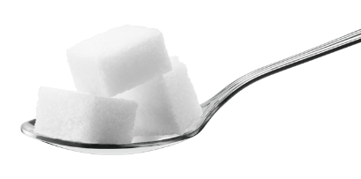
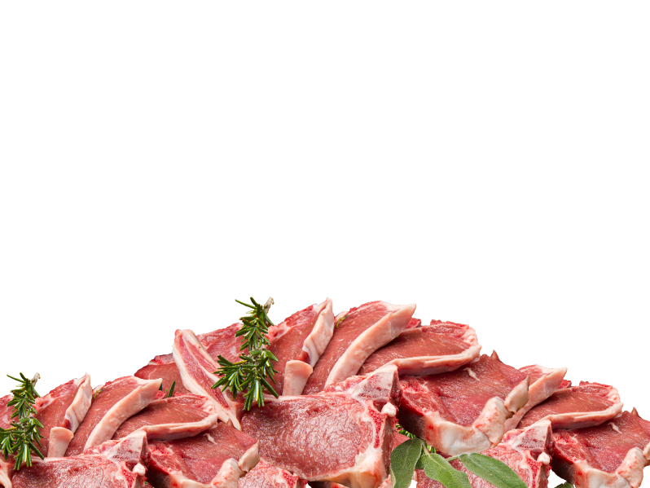

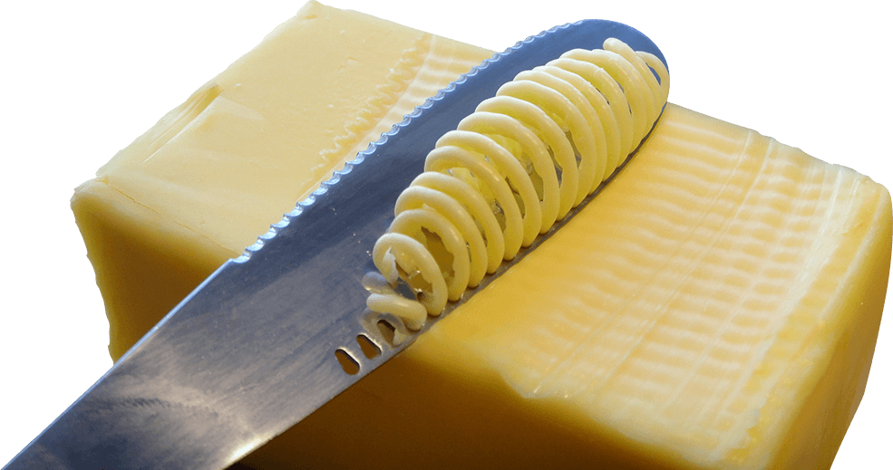
2. UNCOUNTABLE NOUNS
Singular
Things you can’t count in units.
Butter
Coffee
Meat
Sugar
Plural
Measuring Units and
Quantifiers

Slide 4
3. MEASURING UNITS
Both countable and uncountable nouns can be measured with a MEASURING UNIT.
MEASURING UNITS express an exact amount. That’s why they are used in recipes.
cup / glass / spoon / bowl
bottle / can / jar / gallon /bag / box
slice / bunch / dozen
pint / quart / liter / kg / pound

Slide 5
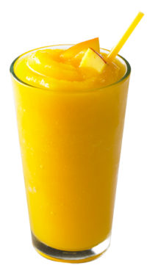
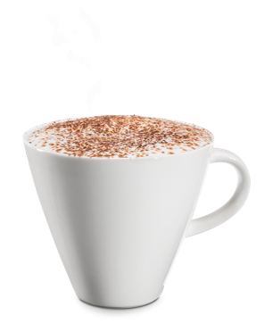
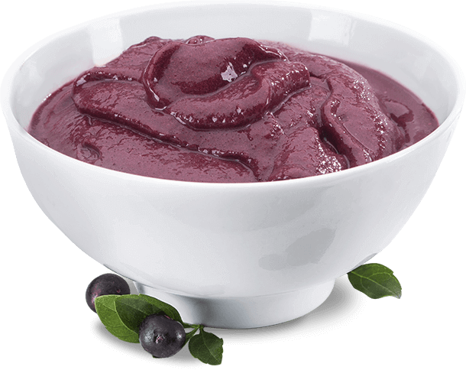
MEASURING UNITS
Cup
Glass
Bowl

Slide 6
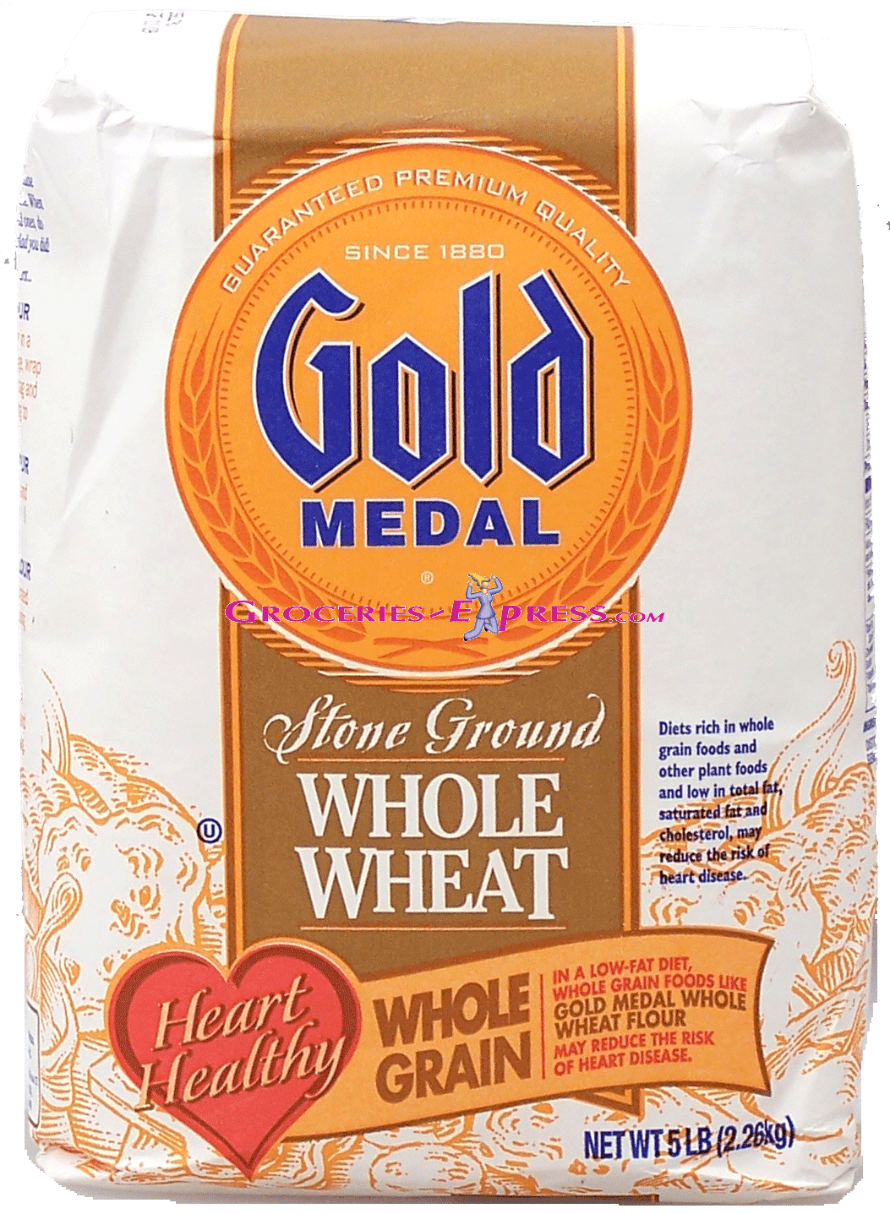
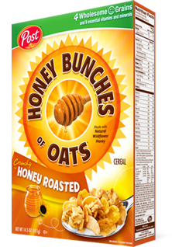
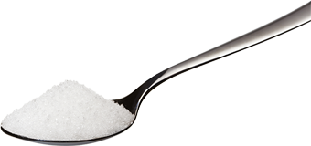
MEASURING UNITS
Spoon
Bag
Box

Slide 7
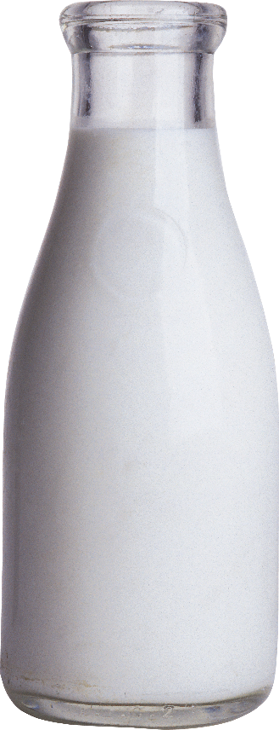
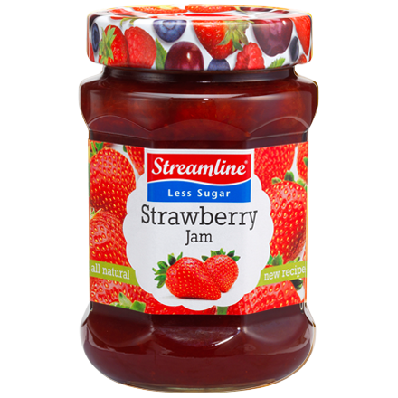
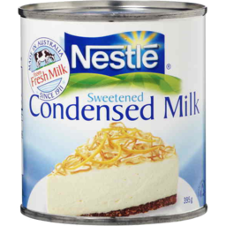
MEASURING UNITS
Bottle
Can
Jar

Slide 8
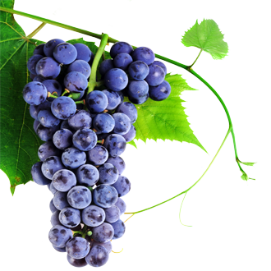
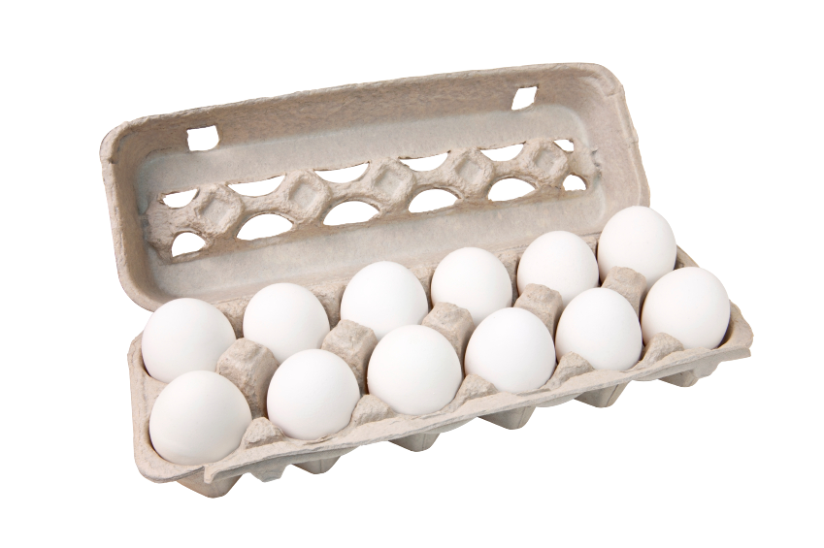
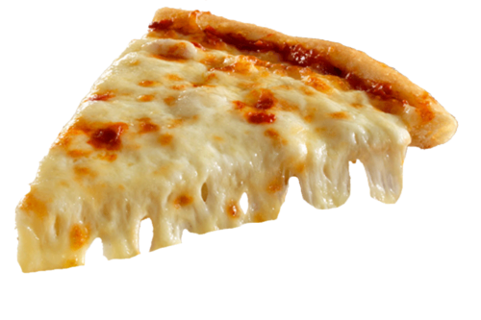
MEASURING UNITS
Bunch
Slice
Dozen

Slide 9
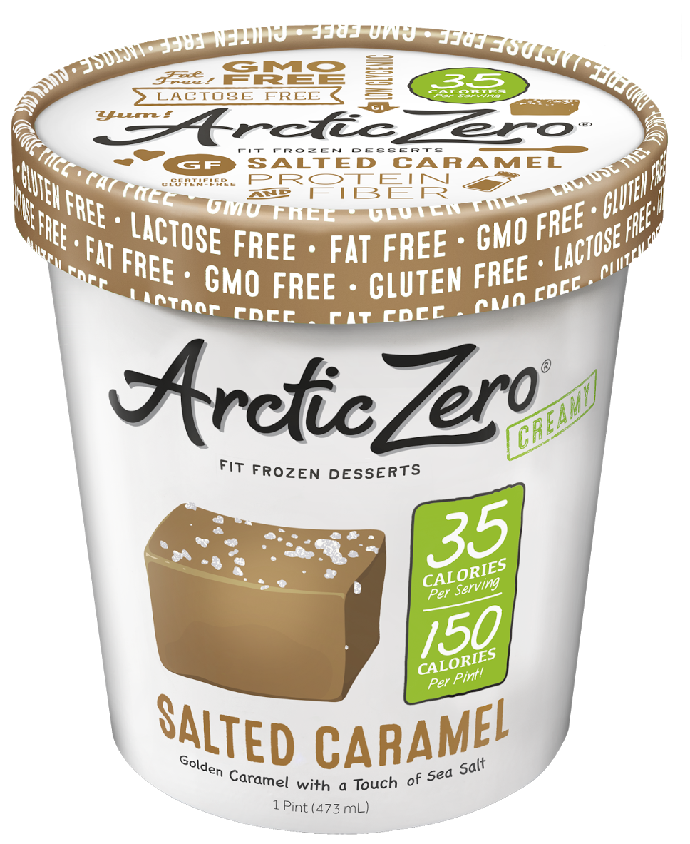
MEASURING UNITS
1 Pint = 0,473176 Liter
(≅0,5L)

Slide 10
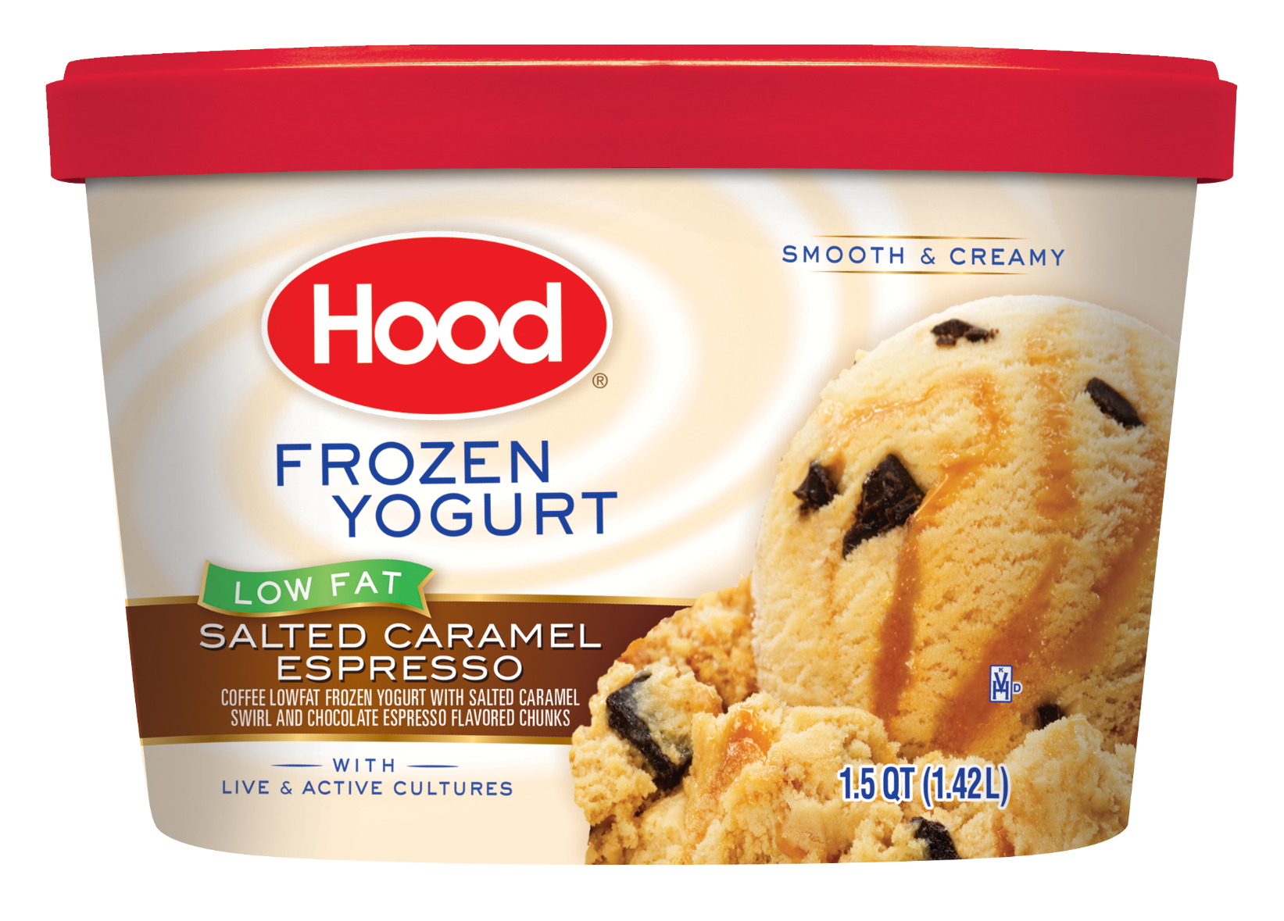
MEASURING UNITS
1 Quart = 0,946353 Liter
(≅1L)

Slide 11
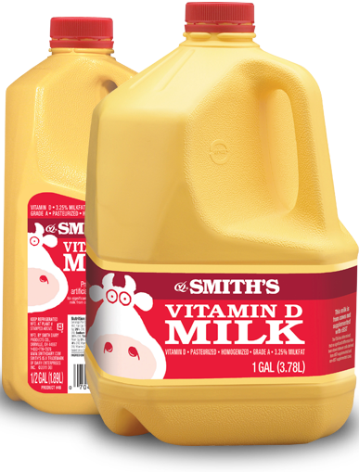
MEASURING UNITS
1 Gallon = 3,78541 Liters
(≅4L)

Slide 12
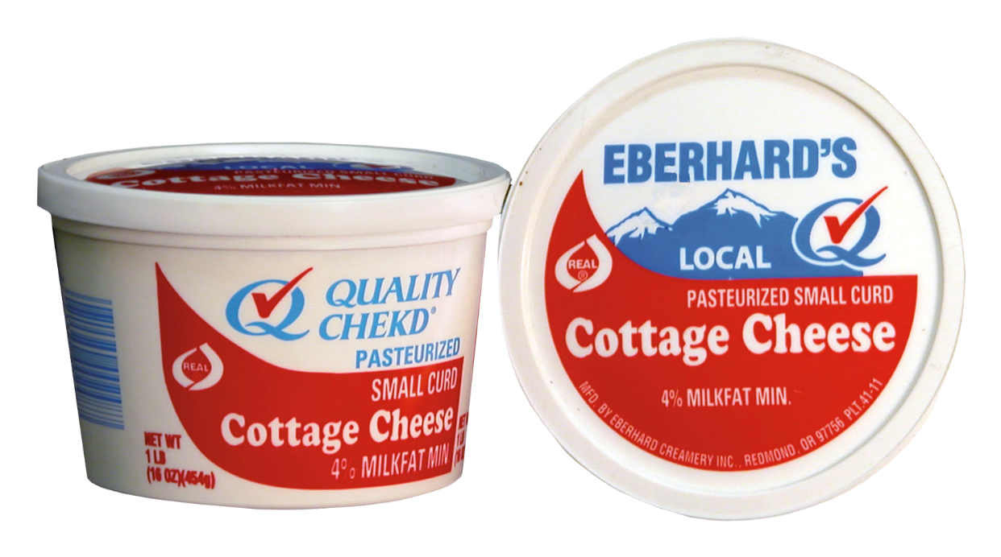
MEASURING UNITS
1 Pound (1lb) = 0,453592 Kg
(≅0,5kg)

Slide 13
4. QUANTIFIERS
Both countable and uncountable nouns can be measured with a QUANTIFIER.
QUANTIFIERS express an amount that is not exact but everybody understands it.
a / an / some / any
much / many / a lot of / lots of
a little / a few
how much / how many?

Slide 14
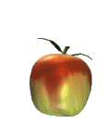

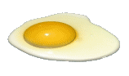
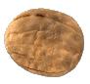
A / AN
We use a/an to talk about singular countable nouns.
a nut
a lemon
an egg
an apple

Slide 15
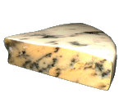

ANY
We use any to talk about plural countable nouns and uncountable nouns (negative and interrogative forms)
There isn’t any cheese.
Is there any cheese?
There aren’t any bananas.
Are there any bananas?

Slide 16
SOME
We use some to talk about plural countable nouns and uncountable nouns
(affirmatives, offerings and requests)

Slide 17
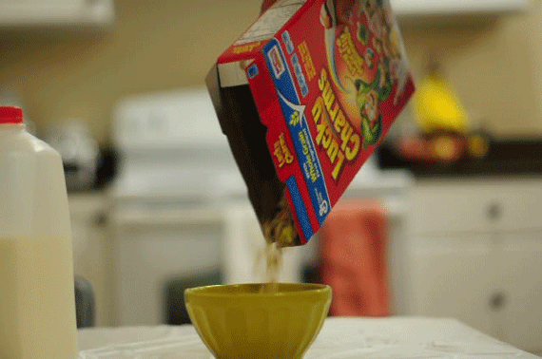
EXAMPLES
I’ll have some flakes for breakfast. (affirmative)

Slide 18
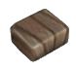
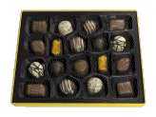
EXAMPLES
Would you like some candies? (offering)

Slide 19
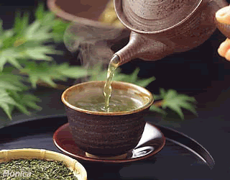
EXAMPLES
Can I have some tea, please? (request)

Slide 20
OTHER QUANTIFIERS
NOUNS | COUNTABLE | BOTH | UNCOUNTABLE
QUANTITY
BIG | many | a lot of | much
SMALL | a few | - | a little

Slide 21
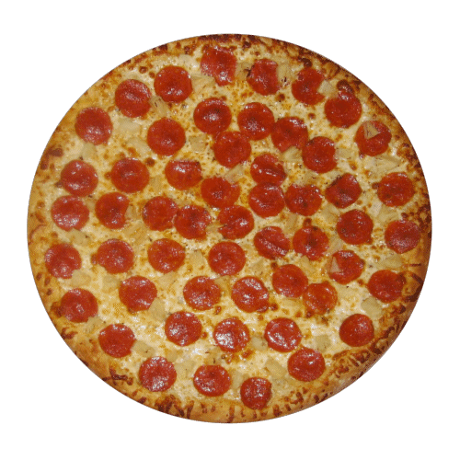
EXAMPLES
I eat many slices of pizza.

Slide 22
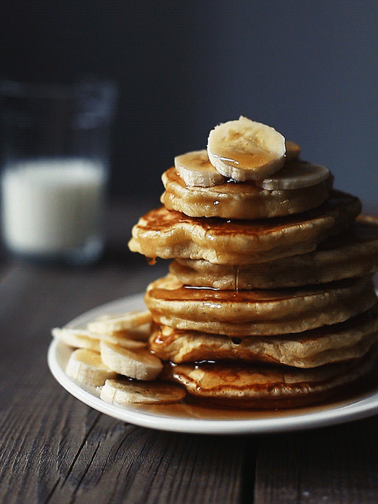
EXAMPLES
My mother usually makes a lot of pancakes.

Slide 23
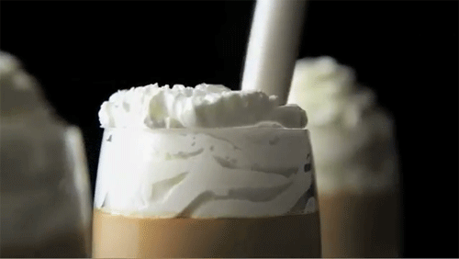
EXAMPLES
A lot of chantilly makes a delicious iced chocolate.

Slide 24
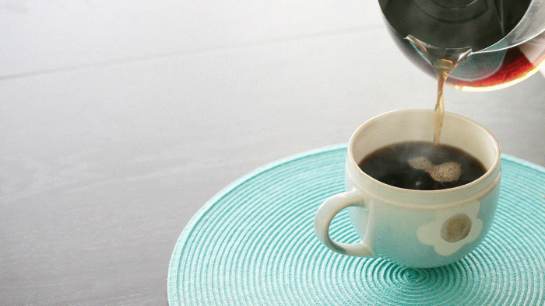
EXAMPLES
The students drink too much coffee.

Slide 25
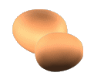
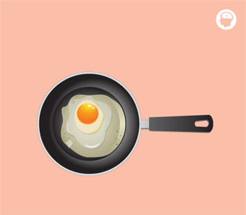
EXAMPLES
We have just a few eggs.

Slide 26
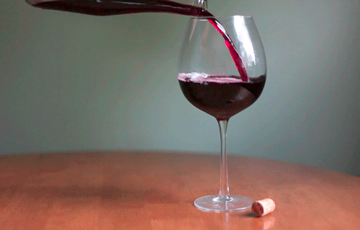
EXAMPLES
A little wine is good for your health.

Slide 27
DIFFERENCE: HOW MANY x HOW MUCH
How many…? to ask about plural countable nouns.
How much…? to ask about uncountable nouns.

Slide 28
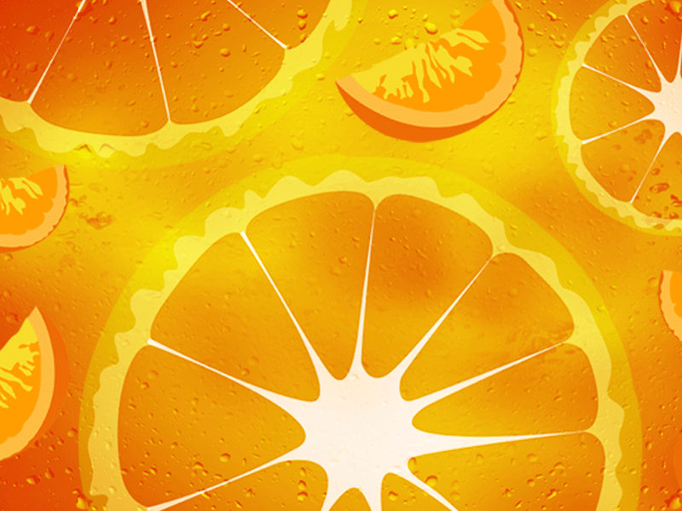
EXAMPLES
How many oranges do we need to make juice?

Slide 29
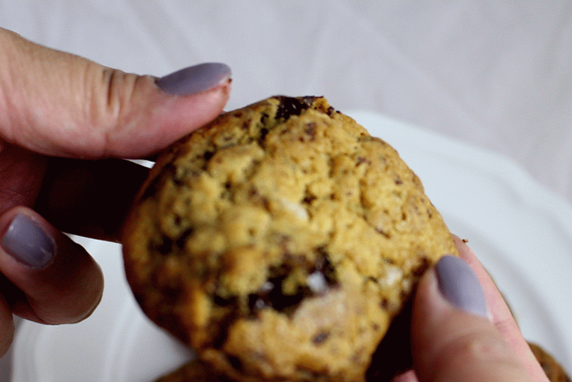
EXAMPLES
How many cookies do you want?

Slide 30
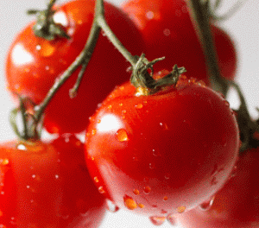
EXAMPLES
How many tomatoes are there in the kitchen?

Slide 31
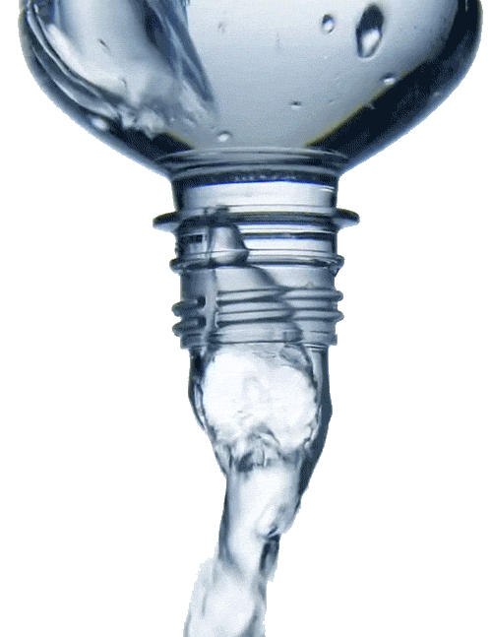
EXAMPLES
How much water do you drink every day?

Slide 32
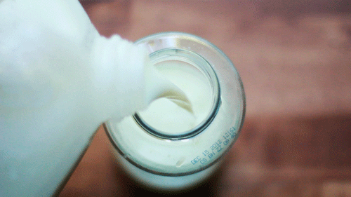
EXAMPLES
How much milk do we need to make a cake?

Slide 33
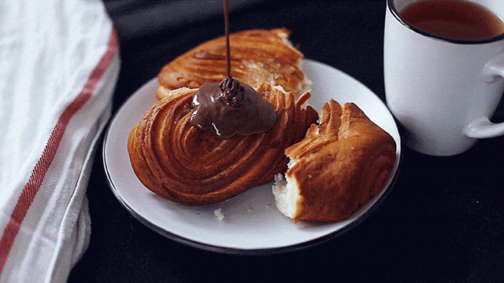
EXAMPLES
How much chocolate sauce would you like?

Slide 34
Taken from: Islcollective PPT

